Slide 1
1.2B Research, Data, and Curation Life Cycles
Introduction to Data Management Concepts and Practices
Helen R. Tibbo
tibbo@email.unc.edu
September 7, 2016

Slide 2
Life Cycle Approach
A life cycle approach is critical to good data curation.
In the traditional archiving model, the content would not reach the archives and the archivist until it was out of use and only of secondary value.
In a paper-based world this was not a bad thing usually.
In a digital world this most likely will mean that the content will not be accessible, usable, or preservable, at least not without great expense and effort.

Slide 3
Lifecycles
Visual way to depict the flow, relationships, and transitions of major components of large systems
Number of individuals and institutions involved at each stage of the lifecycle increases as the complexity of the data increases. We see this with federated data sets or data constructed from many sources
Lifecycles are path dependent

Slide 4
Research Life Cycles
What the People Are Doing

Slide 5
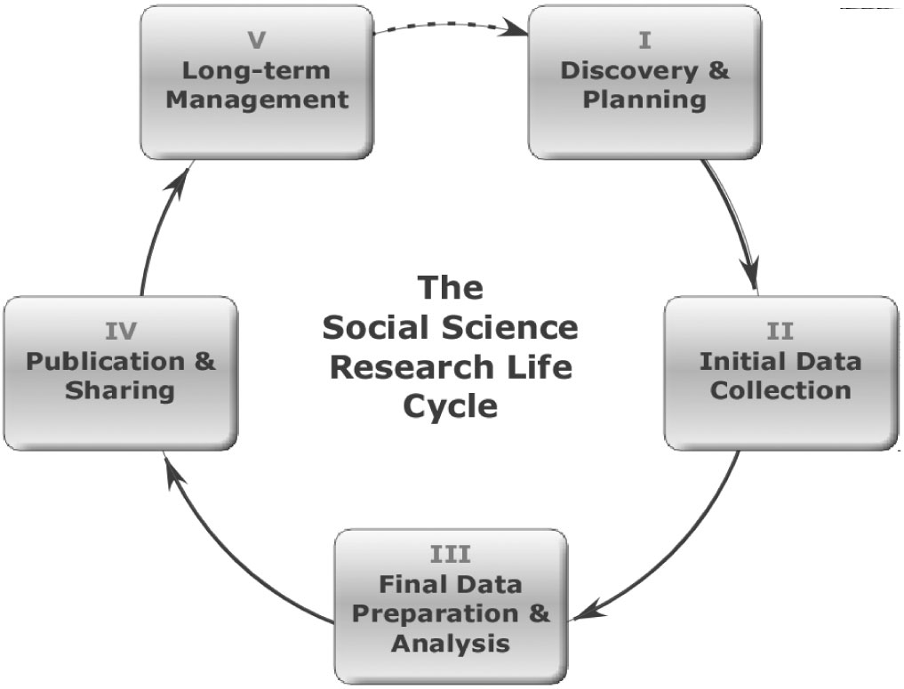
Generic Research Lifecycle
(Green & Gutmann, 2007)

Slide 6
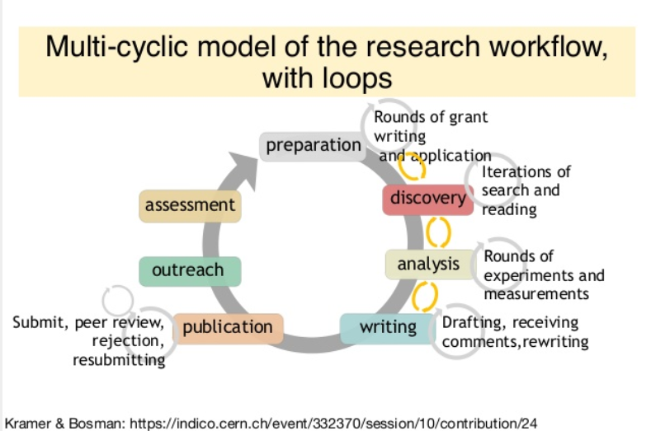

Slide 7
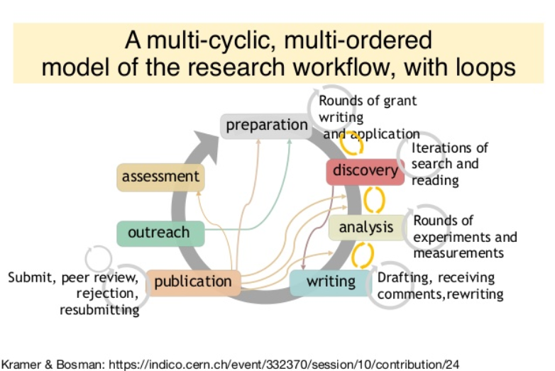

Slide 8
Data Life Cycles
What the Data Are Doing

Slide 9
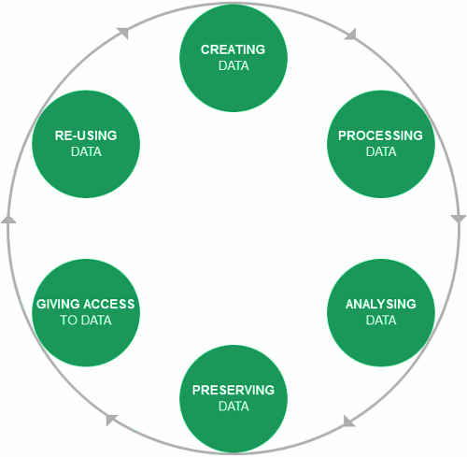
UK Data Archive: Research Data Lifecycle
Corti, L. (2014). Managing and sharing research data: A guide to good practice (1st edition.). Thousand Oaks, CA: SAGE Publications.

Slide 10
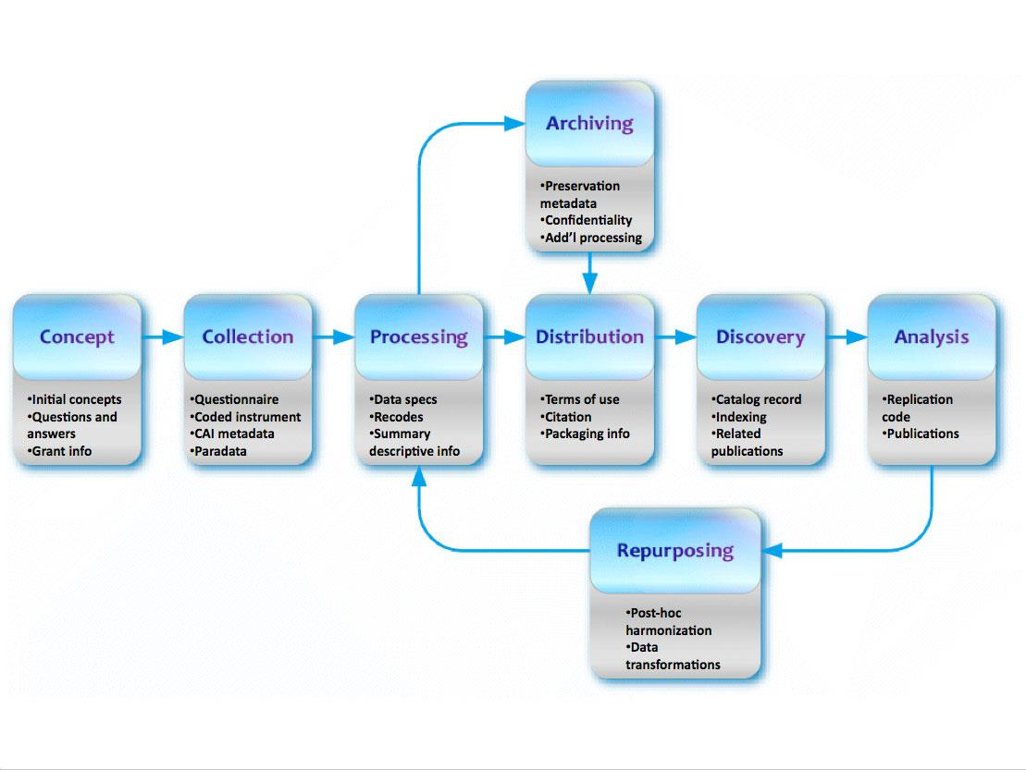
Data Documentation Initiative (DDI) Research Data Lifecycle
Spencer, S. (2012, August 19). What is DDI? DDI Data Documentation Initiative. Retrieved July 26, 2013, from http://www.ddialliance.org/what

Slide 11
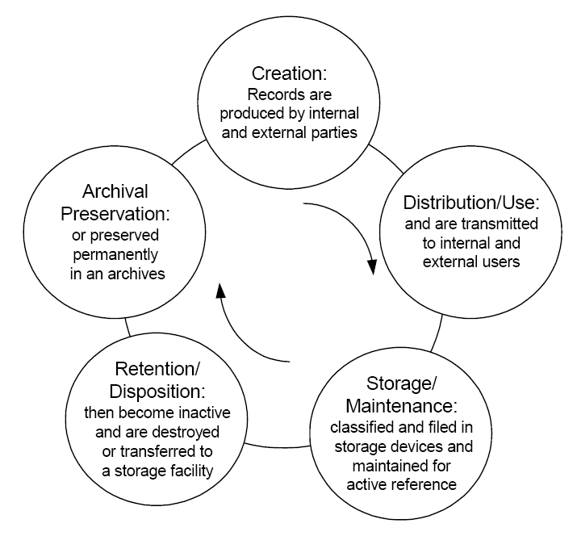
Records Management Approach
Robek, Mary, Gerald F. Brown and David O. Stephens. Information and Records Management: Document-Based Information Systems, Fourth edition. New York, NY: Glencoe, 1995. p.8 [As reproduced in: Kobialka, Kris. "The Electronic Records Lifecycle Specification (ERLS)." Woburn, MA: Global Electronic Records Association, 2003.]

Slide 12
Curation Life Cycles
What the Curators Are Doing

Slide 13
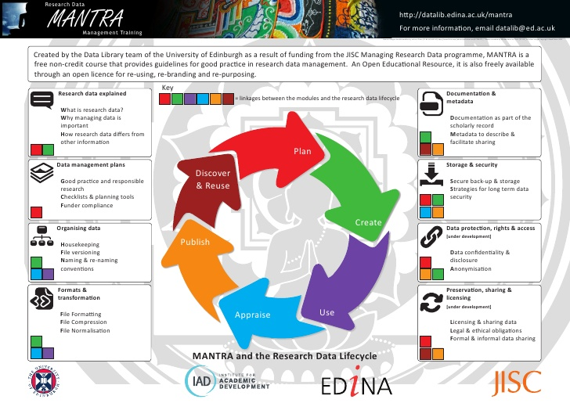
Mantra Research Data Lifecycle
http://www.slideshare.net/edinadocumentationofficer/mantra-poster2

Slide 14
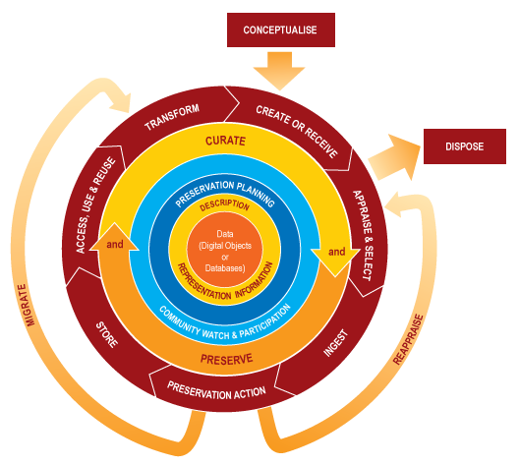
DCC Curation Lifecycle Model
Higgins, S. (2008). “The DCC Curation Lifecycle Model.” International Journal of Digital Curation, 3(1), 134–140. doi:10.2218/ijdc.v3i1.48 & http://www.dcc.ac.uk/resources/curation-lifecycle-model

Slide 15
Key Elements of the DCC Curation Lifecycle Model Data
Data, any information in binary digital form, is at the centre of the Curation Lifecycle. This includes:
Digital Objects: simple digital objects (discrete digital items such as text files, image files or sound files, along with their related identifiers and metadata) or complex digital objects (discrete digital objects made by combining a number of other digital objects, such as websites)
Databases: structured collections of records or data stored in a computer system

Slide 16
Full Lifecycle Actions
Description and Representation Information
Assign administrative, descriptive, technical, structural and preservation metadata, using appropriate standards, to ensure adequate description and control over the long-term. Collect and assign representation information required to understand and render both the digital material and the associated metadata.
Preservation Planning
Plan for preservation throughout the curation lifecycle of digital material. This would include plans for management and administration of all curation lifecycle actions.

Slide 17
Full Lifecycle Actions
Community Watch and Participation
Maintain a watch on appropriate community activities, and participate in the development of shared standards, tools and suitable software.
Curate and Preserve
Be aware of, and undertake management and administrative actions planned to promote curation and preservation throughout the curation lifecycle.

Slide 18
Sequential Actions
Conceptualise
Conceive and plan the creation of data, including capture method and storage options.
Create or Receive
Create data including administrative, descriptive, structural and technical metadata. Preservation metadata may also be added at the time of creation.
Receive data, in accordance with documented collecting policies, from data creators, other archives, repositories or data centres, and if required assign appropriate metadata.

Slide 19
Sequential Actions
Appraise and Select
Evaluate data and select for long-term curation and preservation. Adhere to documented guidance, policies or legal requirements.
Ingest
Transfer data to an archive, repository, data centre or other custodian. Adhere to documented guidance, policies or legal requirements.

Slide 20
Sequential Actions
Preservation Action
Undertake actions to ensure long-term preservation and retention of the authoritative nature of data. Preservation actions should ensure that data remains authentic, reliable and usable while maintaining its integrity. Actions include data cleaning, validation, assigning preservation metadata, assigning representation information and ensuring acceptable data structures or file formats.
Store
Store the data in a secure manner adhering to relevant standards

Slide 21
Sequential Actions
Access, Use and Reuse
Ensure that data is accessible to both designated users and reusers, on a day-to-day basis. This may be in the form of publicly available published information. Robust access controls and authentication procedures may be applicable.
Transform
Create new data from the original, for example: by migration into a different format, or by creating a subset, by selection or query, to create newly derived results, perhaps for publication

Slide 22
Occasional Actions
Dispose
Dispose of data, which has not been selected for long-term curation and preservation in accordance with documented policies, guidance or legal requirements. Typically data may be transferred to another archive, repository, data centre or other custodian. In some instances data is destroyed. The data's nature may, for legal reasons, necessitate secure destruction.
Reappraise
Return data which fails validation procedures for further appraisal and re-selection.
Migrate
Migrate data to a different format. This may be done to accord with the storage environment or to ensure the data's immunity from hardware or software obsolescence.

Slide 23
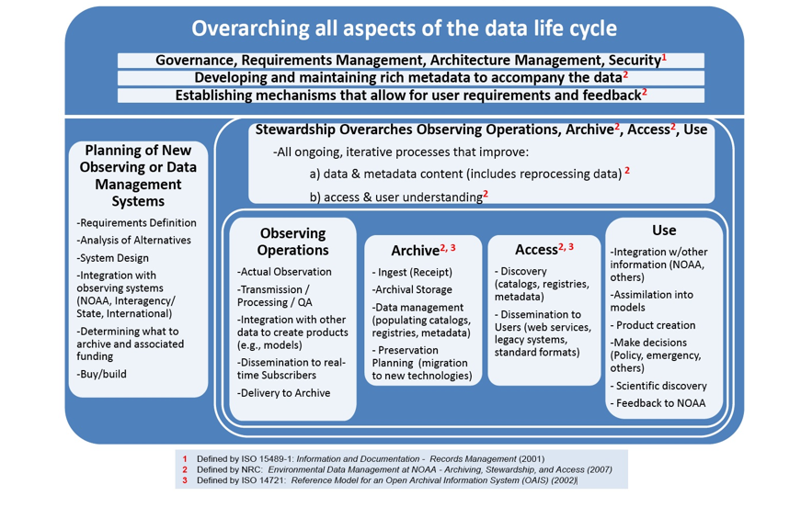
NOAA Environmental Data Life Cycle Functions

Slide 24
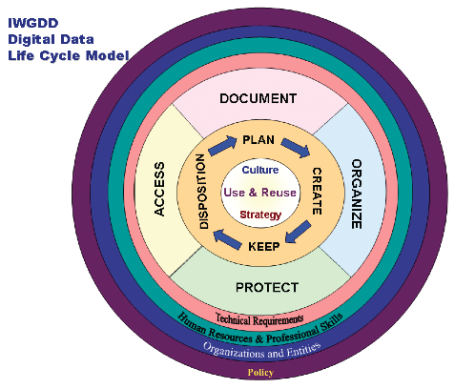
Interagency Working Group on Digital Data - OSPT
http://www.nitrd.gov/about/harnessing_power_web.pdf

Slide 25
Mission Data Lifecycle
UNCLASSIFIED//FOUO
The six phases of the Mission Data Lifecycle provided below illustrate a high level overview of the various stages involved in the management and use of data. The mission data lifecycle supports and contributes to the intelligence cycle: Tasking, Collection, Processing, Exploitation, and Dissemination.
Retain or
Retire
Plan &Task
Tasking
Dissemination
Collection
Analyze &
Exploit
Processing
Acquire
& Access
Exploitation
Discover &
Share
Authorize &
Process
UNCLASSIFIED//FOUO

Slide 26
Summary
Digital/data curation depends on a lifecycle approach
There are numerous lifecycles – pick one that works for you
The best lifecycles reflect the workflow of the content creator, the nature of the data and its audiences, and the mission of the repository.

Slide 27
Digital Curators

Slide 28
The Demand
Curators represent “the human element of a knowledge infrastructure supporting contemporary scholarly practices and are key to developing and sustaining a global system of interoperable digital data and tools across the natural, physical, and social sciences, as well as the humanities” (Weber, Palmer and Chao 2012, 307).
“[T]he relentless and fast-paced advance of digital technology raises unprecedented concerns, but also suggests enormous potential” (Bastian, Harvey, et al. 2010, 244).
2008-2018: expected growth of 23% in employment of digital curators

Slide 29
LIS Landscape
A need for flexibility:
“Qualifications listed for jobs that contain ‘curator’ in the title often vary widely. And job openings that do not contain the term ‘curator’ in the title often require digital curation skills and knowledge”(Franks, 2013).
“LIS schools are trying to respond to the need, but it is not clear they are keeping pace with the burgeoning need for skilled professionals to manage the so-called ‘data deluge’” (Harris-Pierce and Liu, 2012).
Content analysis of LIS program course descriptions and syllabi (58 total programs) (fall 2011 and summer 2012)
Only 13 (22%) of programs currently offer course on data curation or management
Most LIS programs do not have separate courses devoted only to research data management (Creamer et al., 2012)

Slide 30
Exercise 5
Break into groups and try to come up with as many tasks/functions as you can.
We will come back together in 15 minutes and discuss this.

Slide 31
The Digital Curation Role
Digital Curation
Communication
Cyber-infrastructure

Slide 32
The Digital Curation Role
Tripartite role
Digital Curation
Communication
Cyberinfrastructure

Slide 33
Big Question: What knowledge and competencies do professionals need in order to do digital curation work?

Slide 34
Matrix of Digital Curation Knowledge & Competencies
Iteratively developed, based on data sources just identified
Tool for thinking about, planning for, identifying & organizing curriculum
Each unit of curriculum can address one or more dimensions
Helping to address issue of core vs. specialized (optional) educational elements

Slide 35
DigCCurr Matrix of Digital Curation Knowledge and Competencies (http://ils.unc.edu/digccurr/digccurr-matrix.html) Dimensions

Slide 36
Digital Curation Functions & Skills
“Know how” rather than “know that”
Essential (but quite challenging) for educators to address
24 high-level functions & 4 meta-functions, most of which are then composed of dozens of sub-functions

Slide 37
High-Level Functions
Access
Administration
Advocacy & Outreach
Analysis & Characterization of Digital Objects/Packages
Analysis & Evaluation of Producer Information Environment
Archival Storage
Common Services
Collaboration, Coordination, Contracting with External Actors
Data Management
Description, Organization & Intellectual Control
Destruction & Removal
Identifying, Locating & Harvesting
Ingest
Management
Preservation Planning & Implementation
Production
Purchasing & Managing Licenses
Reference & User Support
Selection, Appraisal & Disposition
Systems engineering & development
Transfer
Transformation of Digital Objects/Packages
Use, Reuse & Adding Value to Accessed Information
Validation & Quality Control of Digital Objects/Packages

Slide 38
Meta-Level Functions
Analysis and Documentation of Curation Functions
Education and Sharing of Expertise or Guidance on Curation Functions
Evaluation and Audit of Curation Functions
Research and Development to Support Curation Functions

Slide 39
Lifelong Education
Never before has there been such a need for continuing education for library, archiving, and IT staff.
An amazing array of materials to monitor, read, and absorb.
The web has not made this easier.
Nice also to have face-to-face educational opportunities to make sense of it all and learn with people from similar backgrounds.

Slide 40
DPOE: Digital Preservation Outreach & Education
Library of Congress
The DPOE mission is to foster national outreach and education about digital preservation by building a collaborative network of instructors and partners to provide training to individuals and organizations seeking to preserve their digital content.
Train-the-trainer approach
I taught in the first week-long course, September 2011.
Each of the 24 students has gone home and conducted some level of training.

Slide 41
DPOE Curriculum
The DPOE Baseline Digital Preservation Curriculum consists of 6 easily understandable topics.
Identify . . . the types of digital content you have.
Select . . . what portion of your digital content will be preserved.
Store . . . your selected content for the long term.
Protect . . . your content from everyday threats and emergency contingencies.
Manage . . . and implement requirements for long term management.
Provide . . . access to digital content over time.

Slide 42
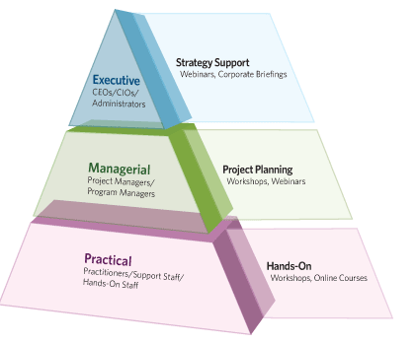
DPOE Pyramid

Slide 43
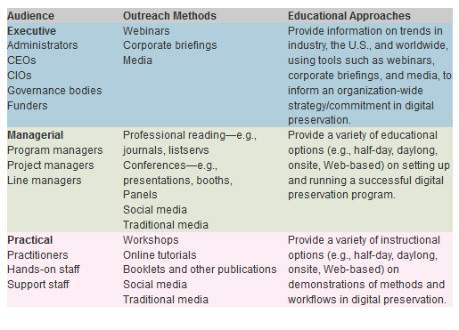
DPOE Audiences

Slide 44
Society of American Archivists’ Digital Archives Specialist Certificate
The DAS Curriculum is structured in four tiers of study
Students can earn a certificate by completing required coursework and passing both course and comprehensive examinations.
Three audiences similar to DPOE:
The Archivist Practitioner is a hands-on, front-line archivist who manages or will manage electronic records personally.
The Archivist Manager is an archivist who has oversight over the work of other professional archivists and who may or may not manage electronic records directly.
The Archivist Administrator is an archivist oversees archivist managers, who is responsible for organizational planning, and who does not manage electronic records directly but must ensure the organization’s capacity to do so.

Slide 45
DigCurV Project
http://www.digcur-education.org/
2011-2013 (Da Vinci Programme from EU)
Collaborating institutions: HATII, Fondazione Rinascimento Digitale, Goettingen State and University Library, Trinity College Dublin, Vilniaus Universiteto Biblioteka, MDR Partners, University of Toronto, UNC-CH

Slide 46

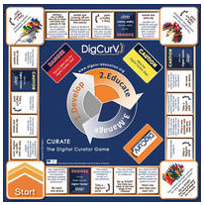
DigCurV
Digital Curator Vocational Education Europe
Funded by the European Commission’s Leonardo da Vinci programme to establish a curriculum framework for vocational training in digital curation.
CURATE The Digital Curator Game is available for download to all Network Members.

Slide 47
Developed “lenses” to focus on digital curation skills and knowledge needed by:
Practitioners
Managers
Administrators
Lenses built on DigCCurr Matrix, DPOE principles and curriculum, and SAA’s DAS curriculum

Slide 48
Skills & Competency Levels
“The DigCurV Curriculum Framework is designed to recognise that digital curation professionals may require different levels of competency and experience in specific skills. To reflect this, the skill requirements identified in the DigCurV lenses are defined using the competency levels shown in the table”.

Slide 49
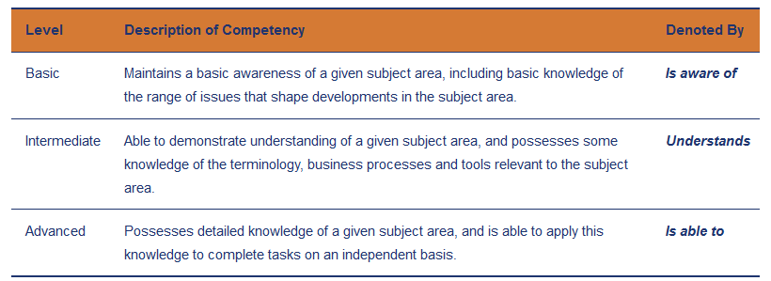
Skills & Competency Levels
For example, practitioners may require a detailed understanding of metadata standards to be able to use them in annotating specific content. Managers, on the other hand, may require only a more limited awareness of such standards to enable strategic evaluation of their use.
http://www.digcurv.gla.ac.uk/skills.html

Slide 50
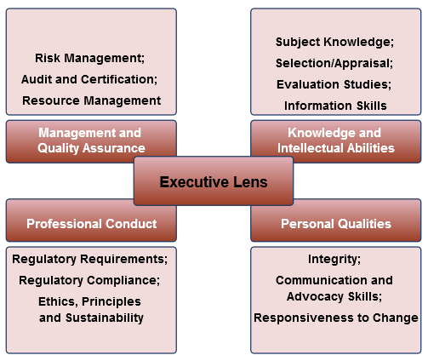
DigCurV Executive Lens
http://www.digcurv.gla.ac.uk/executiveLens.html

Slide 51
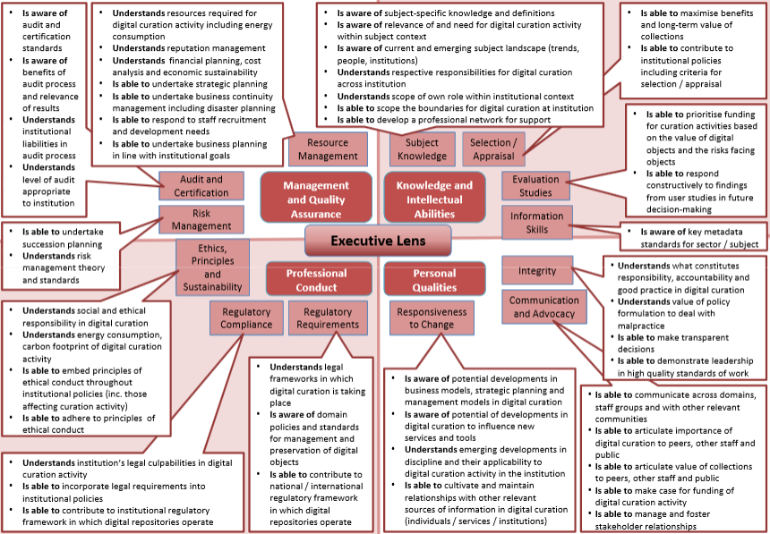
DigCurV Executive Lens

Slide 52
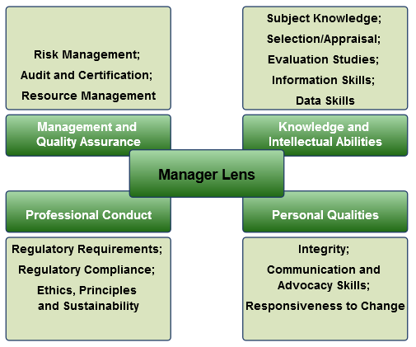
DigCurV Manager Lens
http://www.digcurv.gla.ac.uk/managerLens.html

Slide 53
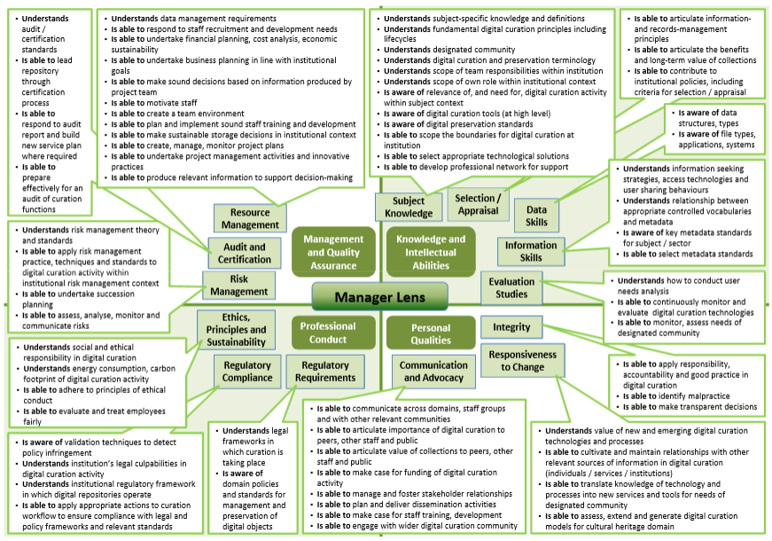
DigCurV Manager Lens

Slide 54
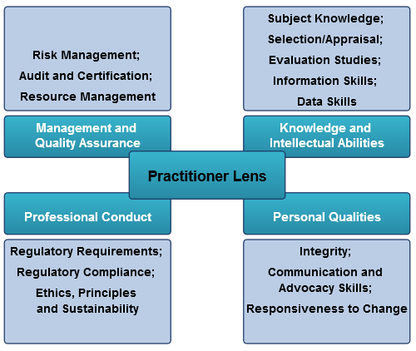
DigCurV Practitioner Lens
http://www.digcurv.gla.ac.uk/practitionerLens.html

Slide 55
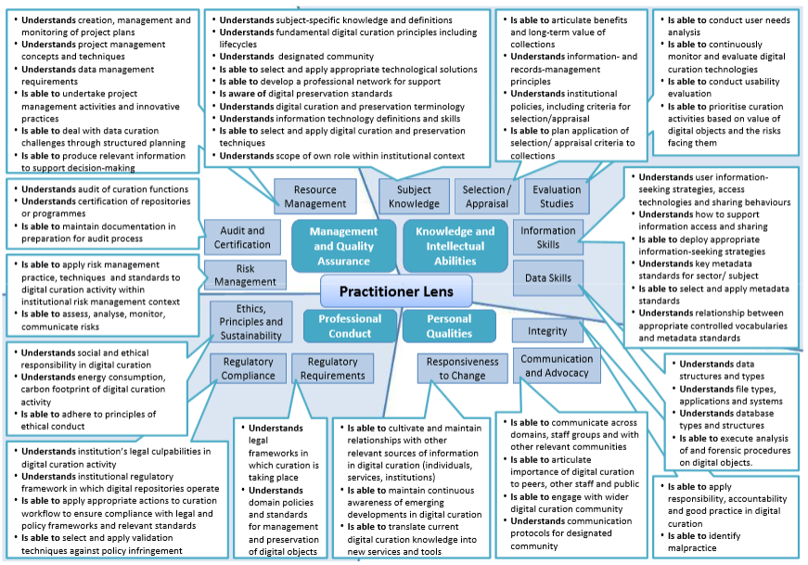
DigCurV Practitioner Lens

Slide 56
Knowledge and Intellectual Abilities (KIA)
Skills in this domain relate to the ability of staff to demonstrate knowledge and competency in specific areas of digital curation. A key component of this knowledge is the application of digital curation to specific market sectors such as the cultural heritage sector.
KIA1: Subject Knowledge
KIA2: Selection/Appraisal
KIA3: Evaluation Studies
KIA4: Information Skills
KIA5: Data Skills

Slide 57
Personal Qualities (PQ)
Skills in this domain relate to the ability of staff to interact and collaborate with other relevant stakeholders in digital curation activities. A key component of this knowledge is the ability to communicate with fellow professionals, colleagues in other departments, staff from external institutions, and members of the public.
PQ1: Integrity
PQ2: Communication and Advocacy Skills
PQ3: Responsiveness to Change

Slide 58
Professional Conduct (PC)
Skills in this domain relate to the ability of staff to conduct themselves within the ethical and legal frameworks that regulate digital curation as a profession.
PC1: Regulatory Requirements
PC2: Regulatory Compliance
PC3: Ethics, Principles and Sustainability

Slide 59
Management & Quality Assurance (MQA)
Skills in this domain relate to the ability of staff to plan, execute, and monitor digital curation activities as part of project groups or larger programmes of work.
MQA1: Risk Management
MQA2: Audit and Certification
MQA3: Resource Management

Slide 60
Summary
Digital curators conduct a wide array of tasks and functions
Few graduate programs offer substantial education for digital curation
There’s an array of spotty continuing education
Training must be lifelong.

Slide 61
Exercise 6
Please break into your groups and discuss what you think were the most important points of today’s presentation for you and your organization.

